Slide 1
Topic Modeling on Austin Chat Data
Memphis Team

Slide 2
Corpus
Seed: Reading 1 (43 documents) and Reading 2 (28 documents)
Wikipedia selection: 1350 documents

Slide 3
Top Wikipedia articles
autism
automatic dependent surveillance-broadcast
addiction
autoerotic asphyxiation
aphasia
anxiolytic
antipsychotic
alcoholism
bipolar spectrum
bipolar disorder
behavior

Slide 4
20 Topics (1-10)
Topic1, translation, use, language, word, translate, text, version, example, pattern, english
Topic2, experience, person, animal, schizophrenia, thought, study, bipolar, term, disorder, mental
Topic3, use, sexual, e-mail, field, message, user, system, internet, allow, pattern
Topic4, committee, general, service, plant, first, member, house, record
Topic5, p, special, force, function, gear, cycle, use, unit, transmission
Topic6, association, behavior, psychology, test, system, journal, process, psychological, information, addiction
Topic7, child, autism, syndrome, autistic, human, parent, often, movement, social, developmental
Topic8, p, b, american, de, john, mm, list, william, label, first
Topic9, self, form, theory, use, person, current, personal, trial, election, action
Topic10, use, drug, effect, work, abuse, substance, medical, dose, induce, include

Slide 5
20 Topics (11-20)
Topic11, state, person, act, law, evidence, court, unite, case, legal, company
Topic12, treatment, cause, patient, symptom, disease, disorder, anxiety, treat, often
Topic13, general, brain, injury, loss, bone, body, speech, type, major, hear
Topic14, therapy, model, learn, psychotherapy, technique, therapist, develop, group, client, method
Topic15, disorder, personality, diagnosis, criterion, diagnostic, type, individual, mental, condition, diagnose
Topic16, use, system, source, current, claim, method, spam, change, result
Topic17, man, term, issue, see, woman, use, character, dog, male, example
Topic18, health, mental, care, illness, medical, nurse, treatment, hospital, patient, clinical
Topic19, n, e, sub, =, group, number, math, g, sup, +
Topic20, b, s, j, p, m, g, mr, food, list, party

Slide 6

Topic 1: Language

Slide 7
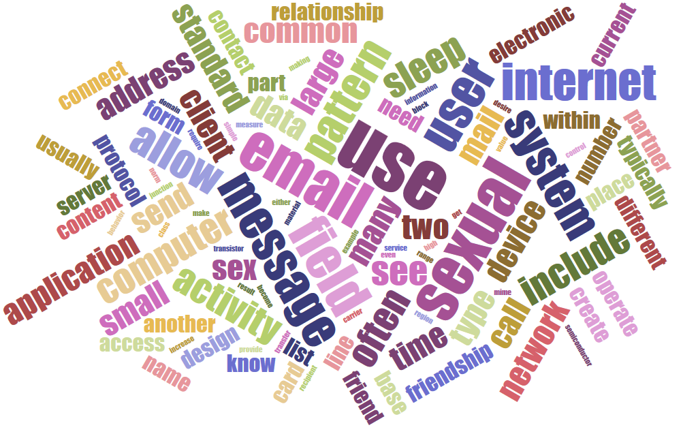
Topic 2: Communication

Slide 8
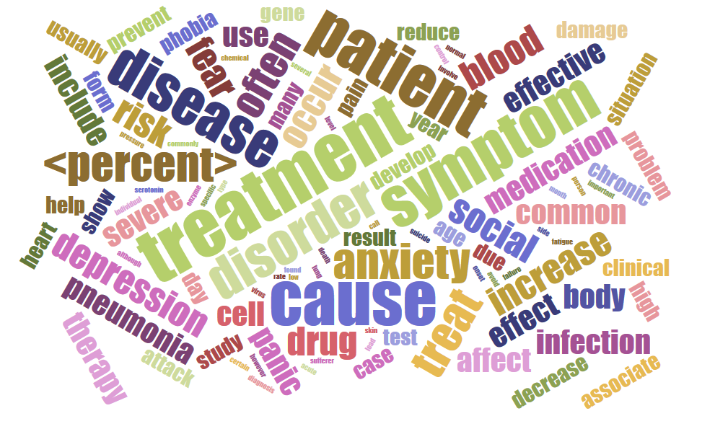
Topic 12: Treatment

Slide 9
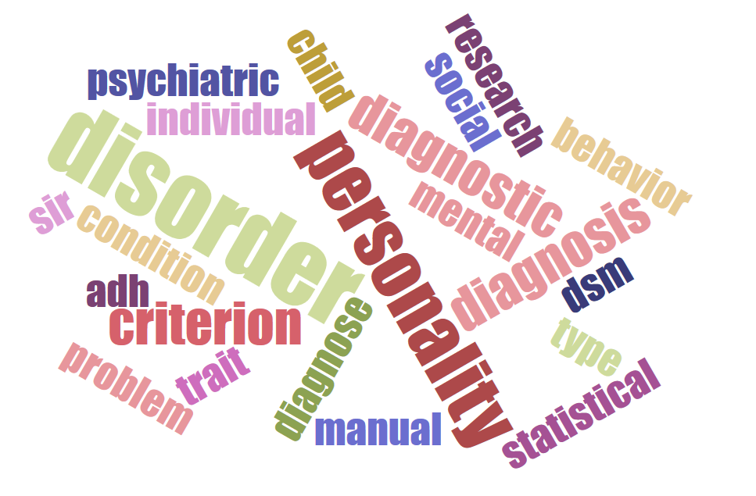
Topic 15: Disorder

Slide 10
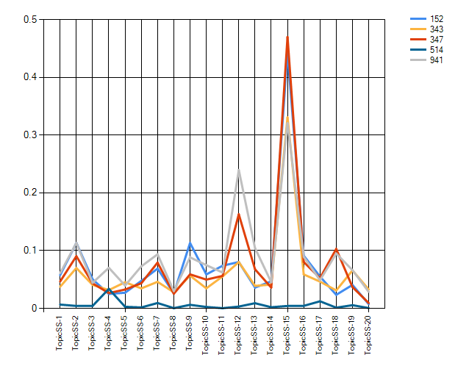
Topic scores in chat room 958

Slide 11
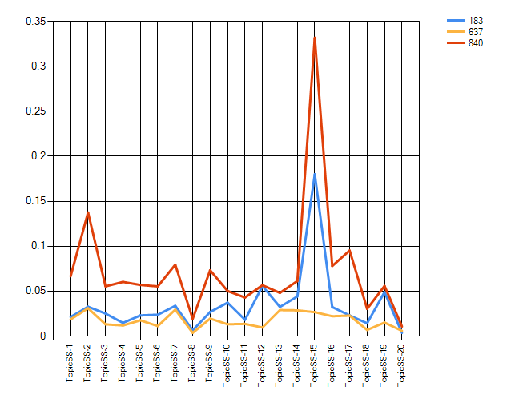
Topic scores in chat room 1080

Slide 12
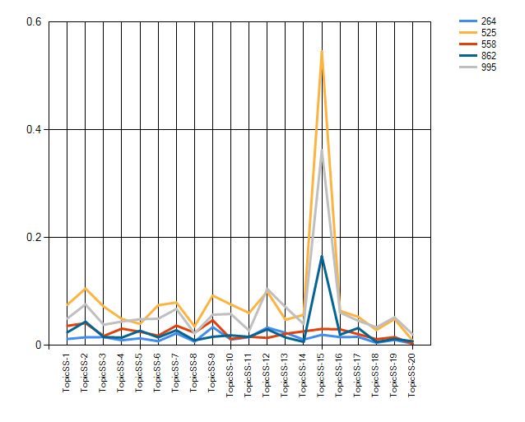
Topic scores in chat room 1000

Slide 13
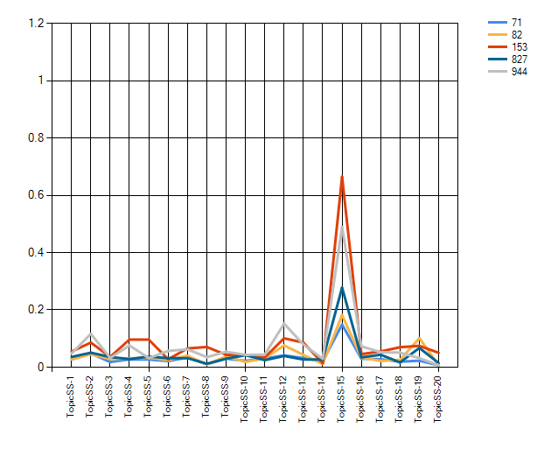
Topic scores in chat room 999

